Slide 1
Data Modeling Using the Entity-Relationship Model

Slide 2
Major Components
Entities
Attributes
Relationships

Slide 3
Entity
Term used to mean three different meanings
Entity type
Entity instance
Entity set

Slide 4
Entity Type
A name/label assigned to items/objects that exist in an environment and that have similar properties
It could be person, place, event or even concept

Slide 5
Entity Instance & Set
A particular object belonging to a particular entity type
Entity Type: Employee
Entity Instance: M. Sharif
Entity Set: All employees

Slide 6
Types of Entity Types
Entity types can be classified into regular/strong/independent ETs or weak/dependent ETs

Slide 7
Weak Entity Types
An entity type whose instances cannot exist without being linked with instances of some other entity type, i.e., they cannot exist independently

Slide 8
Strong Entity Type
A strong/regular entity type is the one whose instances can exist independently, i.e., without being linked to other instances
Strong ETs have their own identity

Slide 9
Naming Entity Types
Singular noun recommended
Organization specific names
Write in capitals
Abbreviations can be used, be consistent

Slide 10
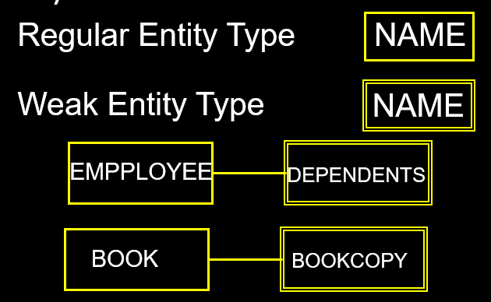
Symbols

Slide 11
ER Model Concepts
Attributes
They are properties used to describe an entity.
Each attribute has a data type
E.g. integer, string, subrange, enumerated type, …

Slide 12

Symbols for Attributes
Each represented as an oval, linked with an ET symbol

Slide 13
Types of Attributes
Single vs composite
Single valued vs multi-valued
Stored vs derived
Complex attribute

Slide 14
Types of Attributes
Simple
Each entity has a single atomic value for the attribute. For example, SSN or Sex.
Composite
The attribute is composed of several components. For example:
Address(House#, Street, City, State, ZipCode, Country),
Name(FirstName, MiddleName, LastName).
Multi-valued
An entity may have multiple values for that attribute. For example:
PreviousDegrees of a STUDENT.
Stored and Derived

Slide 15
Types of Attributes
Complex attribute - The composite and multi-valued attributes may be nested arbitrarily to any number of levels,
For example, PreviousDegrees of a STUDENT is a composite multi-valued attribute denoted by {PreviousDegrees (College, Year, Degree, Field)}
Multiple PreviousDegrees values can exist
Each has four subcomponent attributes:
College, Year, Degree, Field

Slide 16
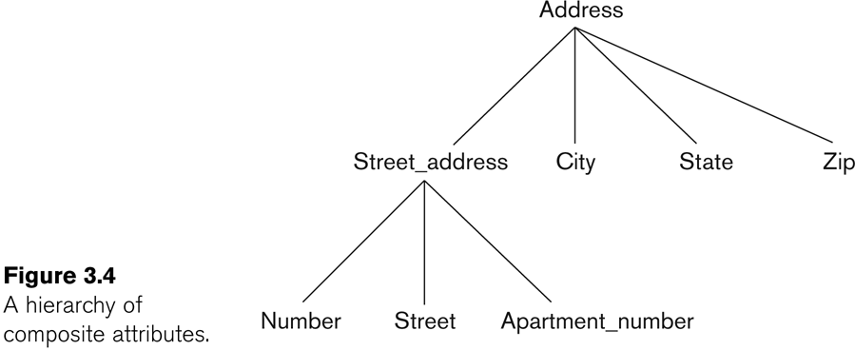
Example of a composite attribute

Slide 17
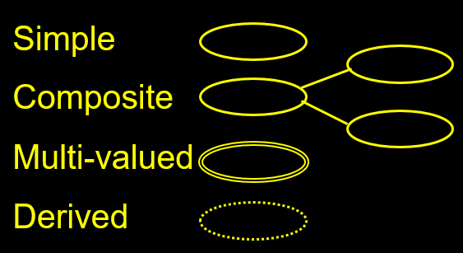
Symbols for Attributes

Slide 18
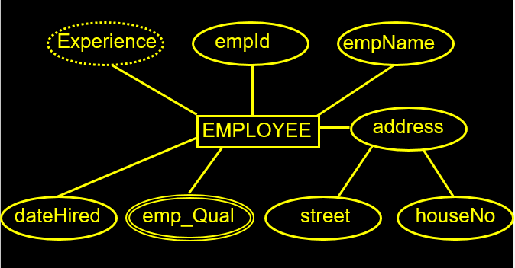
Example

Slide 19
Entity Types and Key Attributes
Entities with the same basic attributes are grouped into an Entity type.
For example, the entity type EMPLOYEE and PROJECT.
Key attribute
For example, SSN of EMPLOYEE.

Slide 20
Key Attributes
A key attribute may be composite.
VehicleTagNumber is a key of the CAR entity type with components (Number, State).
An entity type may have more than one key.
The CAR entity type may have two keys:
VehicleId (popularly called VIN)
VehicleTagNumber (Number, State), aka license plate number.
Each key is underlined

Slide 21
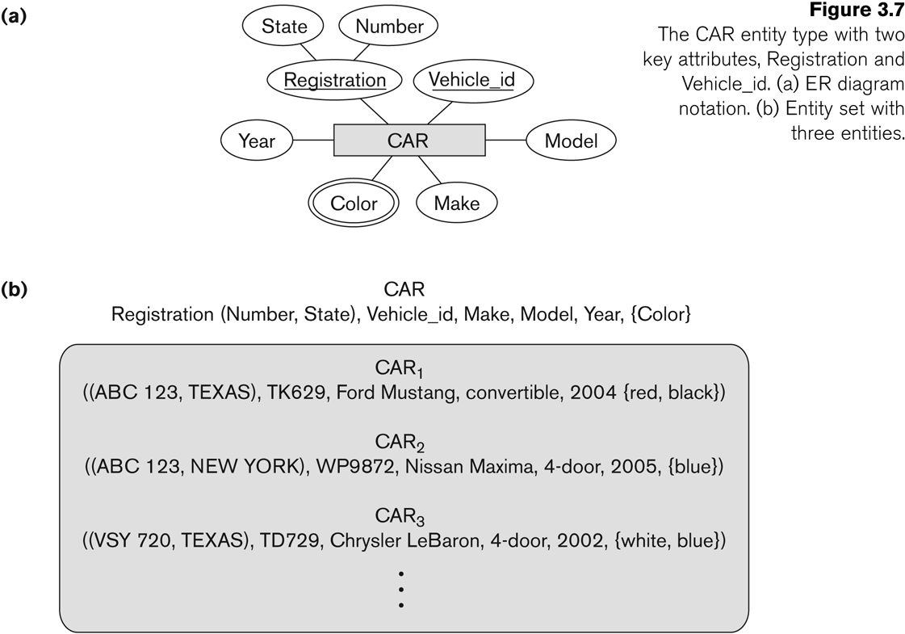
Entity Type CAR with two keys and a corresponding Entity Set
Entity set is the current state of the entities that is stored in the database

Slide 22
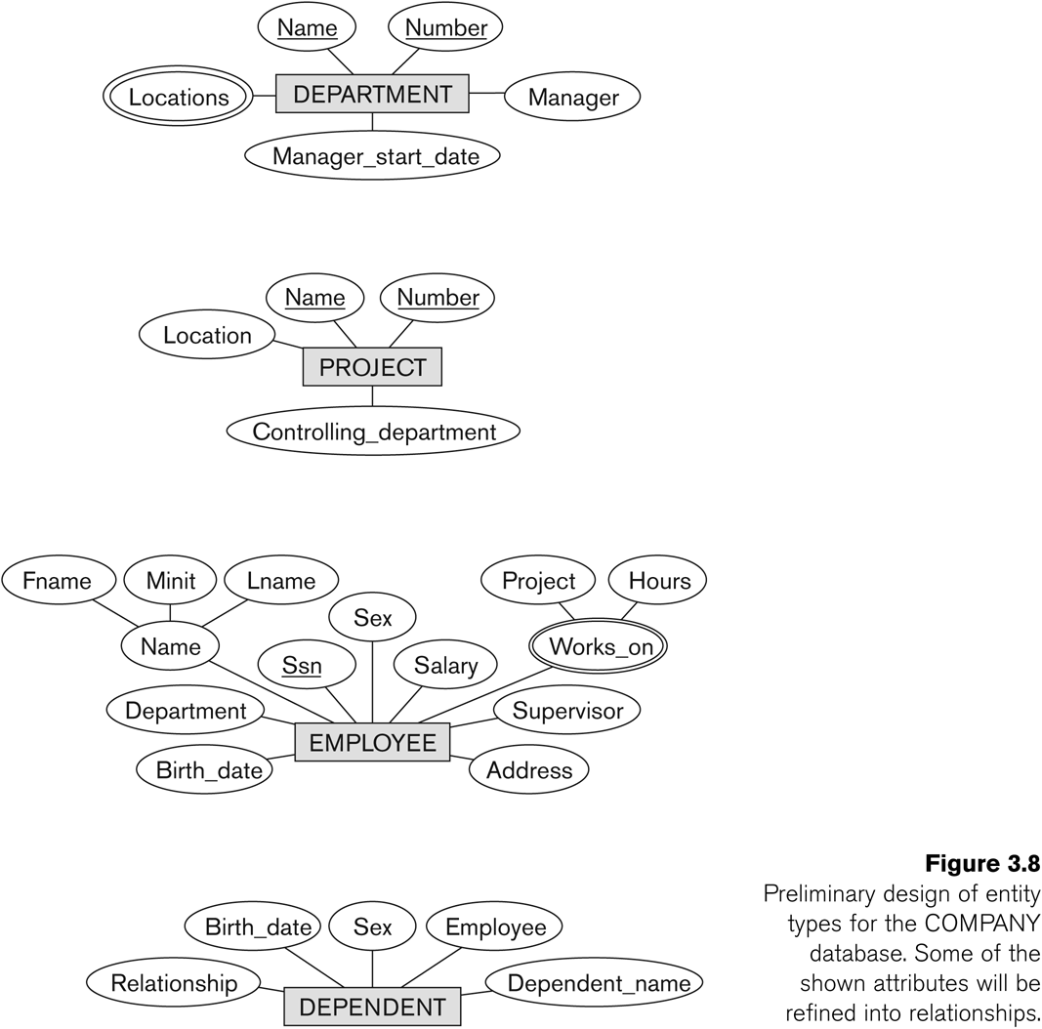
Initial Design of Entity Types: EMPLOYEE, DEPARTMENT, PROJECT, DEPENDENT
Entity types in the COMPANY database:
DEPARTMENT
PROJECT
EMPLOYEE
DEPENDENT

Slide 23
Refining the initial design by introducing relationships
Some aspects in the requirements will be represented as relationships
ER model has three main concepts:
Entities (and their entity types and entity sets)
Attributes (simple, composite, multivalued)
Relationships (and their relationship types and relationship sets)

Slide 24
Relationships
A relationship relates two or more distinct entities with a specific meaning.
For example, EMPLOYEE John works on the ProductX PROJECT,
EMPLOYEE Franklin manages the Research DEPARTMENT.
Relationships of the same type are grouped into a relationship type.
Degree of a relationship type is the no of participating entity types.
Both MANAGES and WORKS_ON are binary relationships.

Slide 25
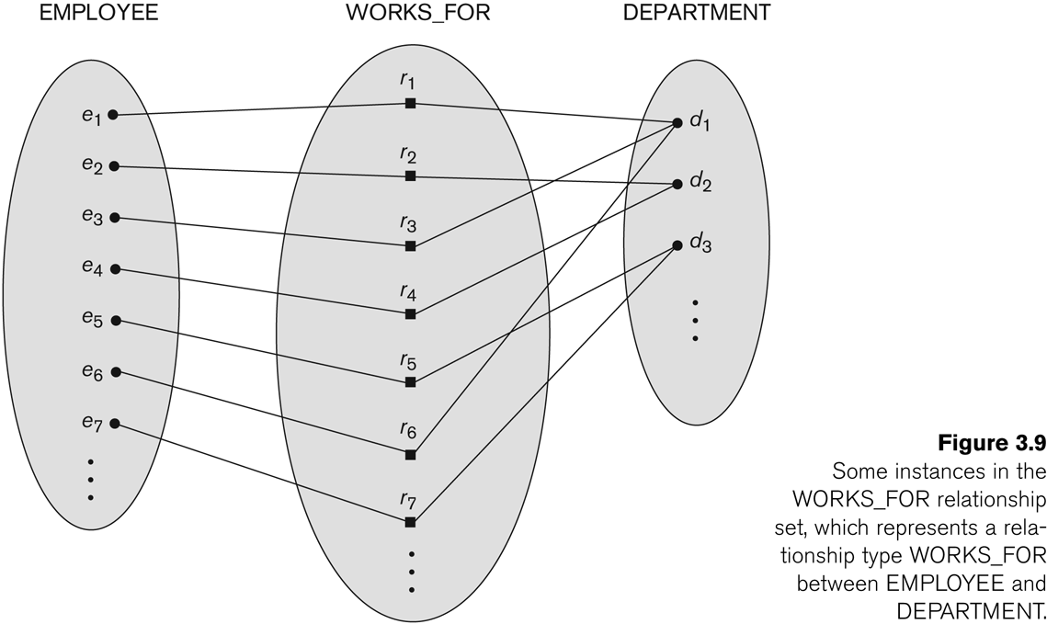
Relationship instances of the WORKS_FOR relationship between EMPLOYEE and DEPARTMENT

Slide 26
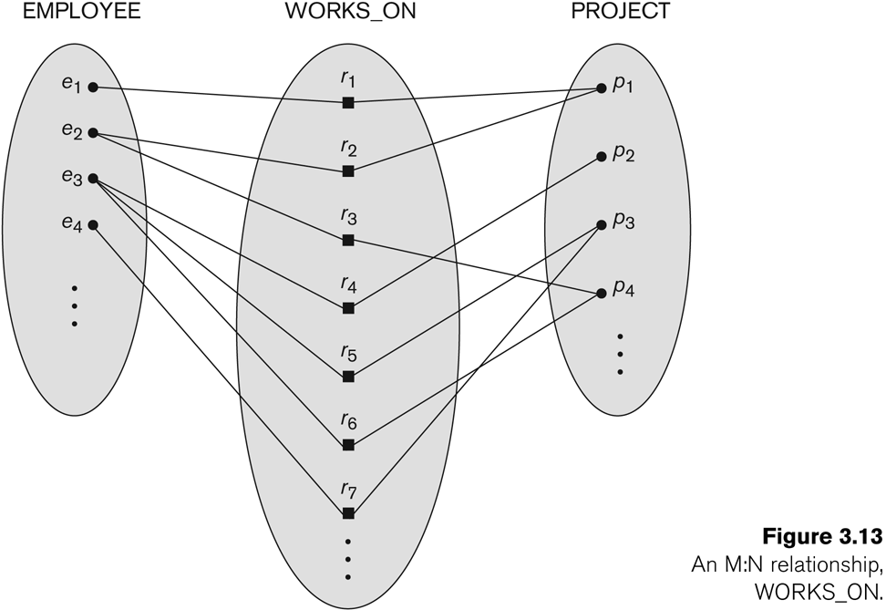
Relationship instances of the WORKS_ON relationship between EMPLOYEE and PROJECT

Slide 27
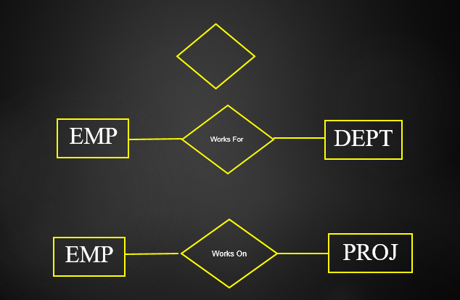
Symbol

Slide 28
Relationship type vs. relationship set
Relationship Set:
A relationship set is a set of relationships of same type.
Relationship Type:
Identifies the relationship name and the participating entity types
Also identifies certain relationship constraints

Slide 29
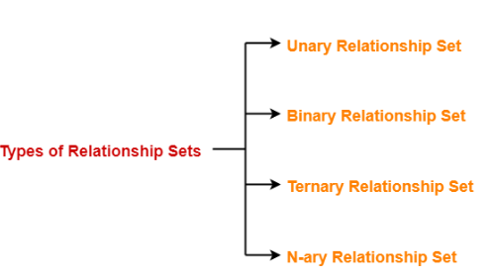
Types of Relationship Set
The number of entity sets that participate in a relationship set is termed as the degree of that relationship set. Thus

Slide 30
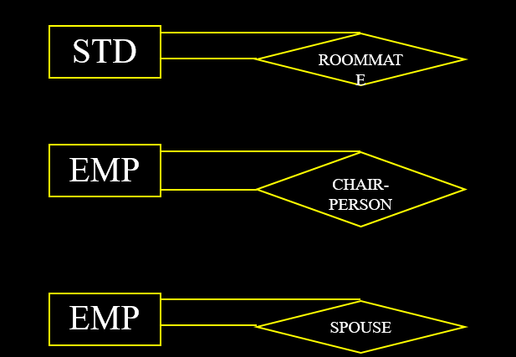
Unary Relationship
An ET linked with itself, also called recursive relationship
Example Roommate, where STUDENT is linked with STUDENT

Slide 31
COMPANY database: relationships
Six relationship types are identified
All are binary relationships( degree 2)
WORKS_FOR (between EMPLOYEE, DEPARTMENT)
MANAGES ( between EMPLOYEE, DEPARTMENT)
CONTROLS (between DEPARTMENT, PROJECT)
WORKS_ON (between EMPLOYEE, PROJECT)
SUPERVISION (between EMPLOYEE (as subordinate), EMPLOYEE (as supervisor))
DEPENDENTS_OF (between EMPLOYEE, DEPENDENT)

Slide 32
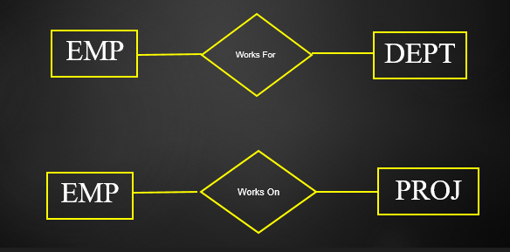
Example

Slide 33
Binary Relationships
May also have instances, that can be formally described in an ordered pair form
Employee and Project
{(E1001, A), (E1020, B), (E1002, B), (E1058, C)}

Slide 34
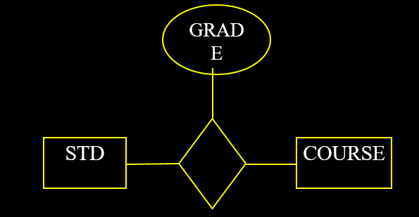
Attributes of the Relationships
The key ( combination of key STD+Course )
The relationships can have their descriptive attributes
Where to place

Slide 35
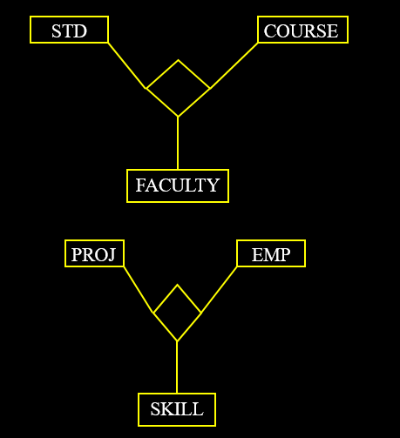
Ternary Relationships
One that involves three entity types
STUDENT-CLASS-FACULTY

Slide 36
Constraints on Relationships type
Constraints on Relationship Types (ratio constraints)
Cardinality Ratio (specifies maximum participation)
One-to-one (1:1)
One-to-many (1:N) or Many-to-one (N:1)
Many-to-many (M:N)
Existence Dependency Constraint (specifies minimum participation) (also called participation constraint)
zero (optional participation, not existence-dependent)
one or more (mandatory participation, existence-dependent)

Slide 37
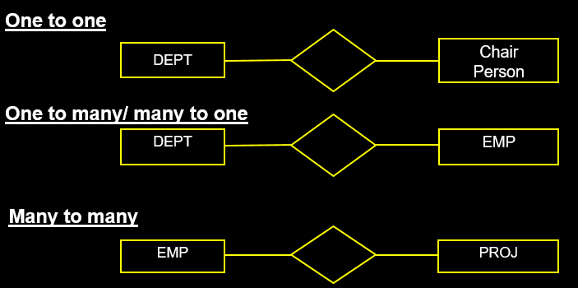
Types of Cardinalities

Slide 38
Many-to-one (N:1) Relationship

Slide 39
Many-to-many (M:N) Relationship

Slide 40
Minimum Cardinality
Determines whether the link is compulsory or optional
Important, since it effects the implementation

Slide 41
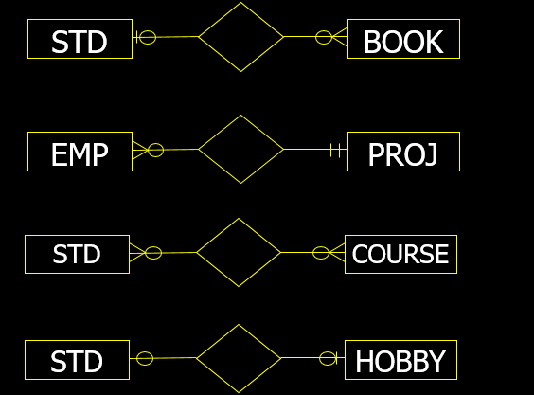
Cardinality Example(Crow's Foot Notation)

Slide 42
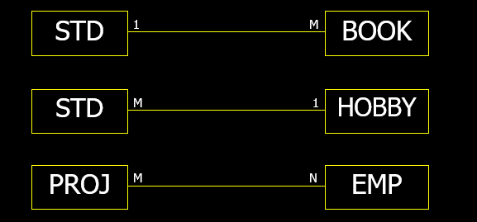
Other Notations(Chen )

Slide 43
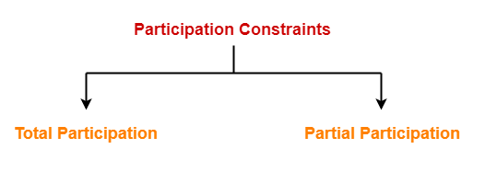
Participation Constraints-
Participation constraints define the least number of relationship instances in which an entity must compulsorily participate.
There are two types of participation constraints-

Slide 44
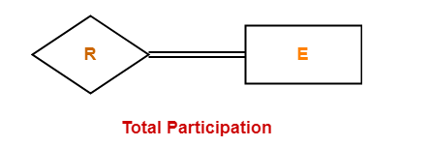
Total Participation-
It specifies that each entity in the entity set must compulsorily participate in at least one relationship instance in that relationship set.
That is why, it is also called as mandatory participation.
Total participation is represented using a double line between the entity set and relationship set.

Slide 45
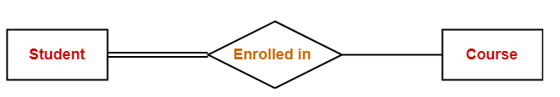
Example
Double line between the entity set “Student” and relationship set “Enrolled in” signifies total participation.
It specifies that each student must be enrolled in at least one course.

Slide 46
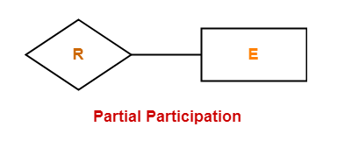
Partial Participation-
It specifies that each entity in the entity set may or may not participate in the relationship instance in that relationship set.
That is why, it is also called as optional participation.
Partial participation is represented using a single line between the entity set and relationship set.

Slide 47
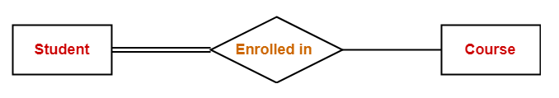
Example
Single line between the entity set “Course” and relationship set “Enrolled in” signifies partial participation.
It specifies that there might exist some courses for which no enrollments are made.

Slide 48
Relationship between Cardinality and Participation Constraints-
Minimum cardinality tells whether the participation is partial or total.
If minimum cardinality = 0, then it signifies partial participation.
If minimum cardinality = 1, then it signifies total participation.
Maximum cardinality tells the maximum number of entities that participates in a relationship set.

Slide 49
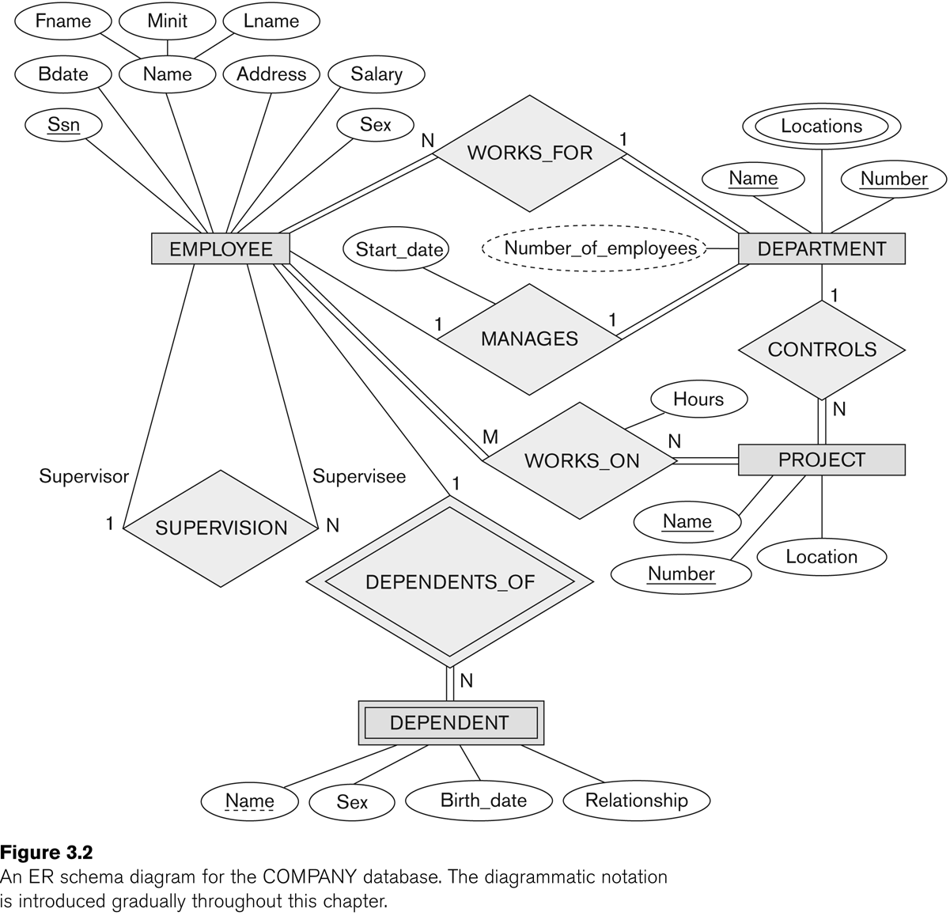
ER DIAGRAM – Relationship Types are: WORKS_FOR, MANAGES, WORKS_ON, CONTROLS, SUPERVISION, DEPENDENTS_OF

Slide 50
Steps to draw an ER diagram
Get problem description
Define Entities
Add Attributes
Specify Key, multiple, composite attributes
Add Relations
Specify Cardinality, total/partial relations
Iterate

Slide 51
Steps to draw an ER diagram
Essential to further design, but often given little care:
Is an entity a weak entity (key?)
Multivalued attributes
Derived attribute
Total/partial participation
Cardinality ratio

Slide 52
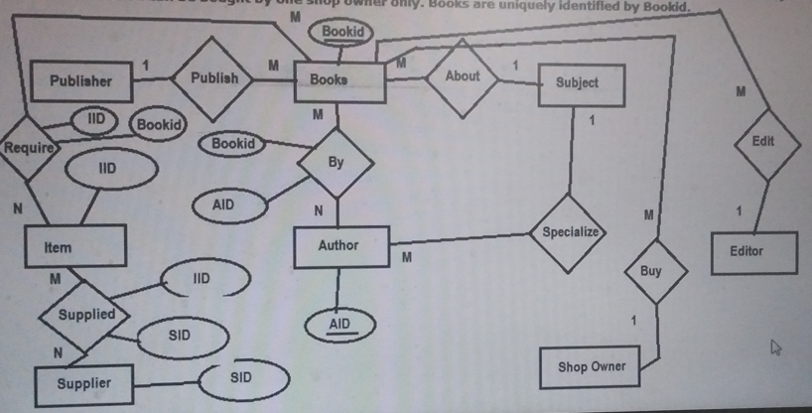
Problem
Draw E\R model for the Publishing company database with the following requirements
A publishing company produces books on various subjects. The books are written by authors who specialize in one particular subject. The company employs editors who, not necessarily being specialists in a particular area, each take sole responsibility for editing one or more book publications. Every book require some items for publication. These items supplied by suppliers. One supplier can supply many items. Shop owner buys books from the publisher . Shop owner can buy many books but one book can be bought by one shop owner only. Books are uniquely identified byBookid.

Slide 53
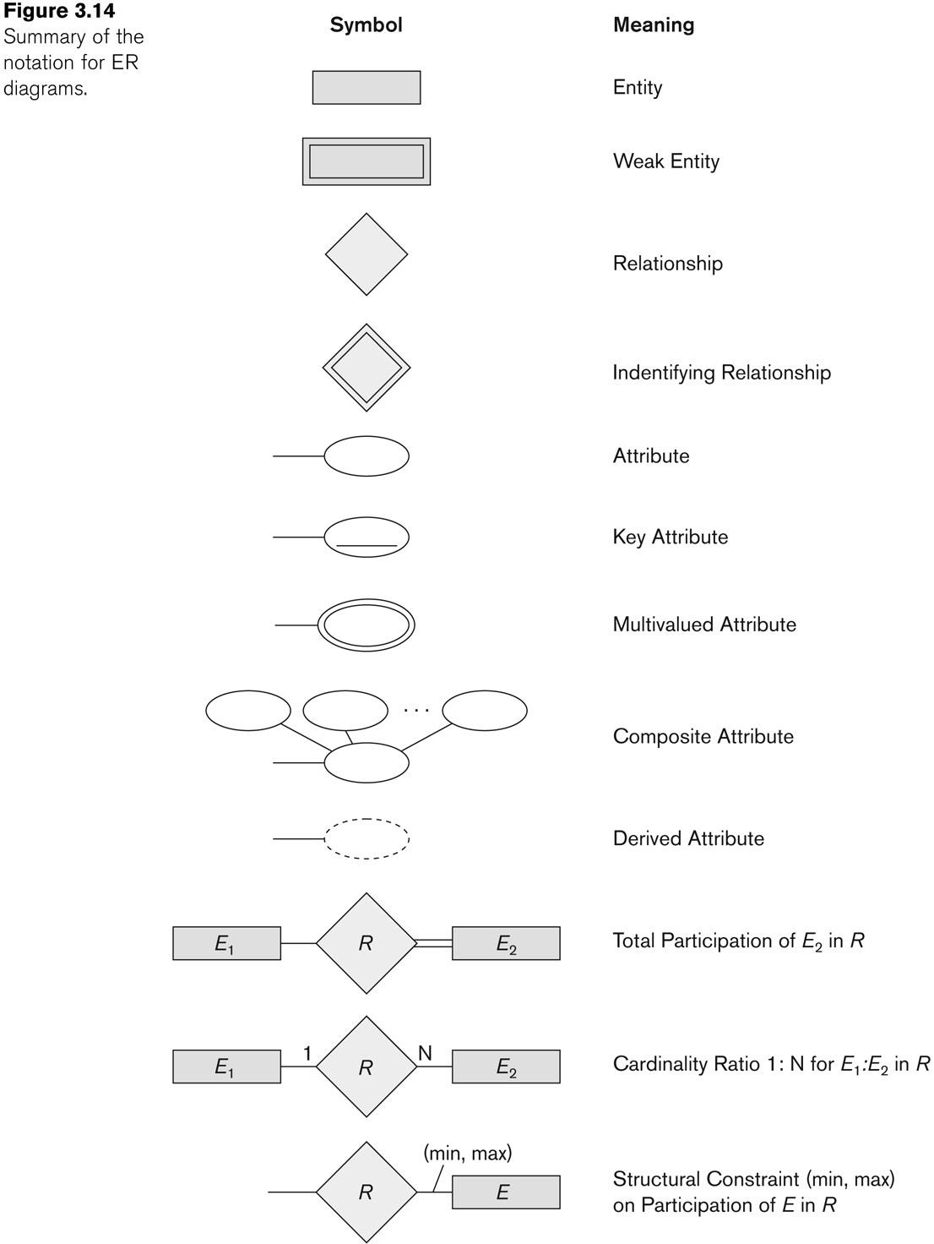
Alternative (min, max) notation for relationship Structural constraints:
Specifies that each entity e in E participates in at least min and at most max relationship instances in R
Default(no constraint): min=0, max=n
Must have min ≤ max, min ≥ 0, max ≥ 1
Derived from the knowledge of mini-world constraints

Slide 54
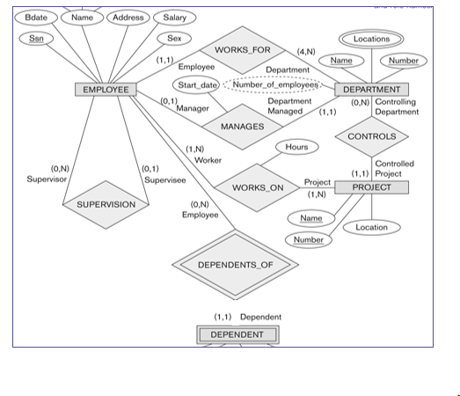
min, max - notation

Slide 55
notation for ER diagrams

Slide 56
Relationships of Higher Degree
Relationship types of degree 2 are called binary
Relationship types of degree 3 are called ternary and of degree n are called n-ary
Constraints are harder to specify for higher-degree relationships (n > 2) than for binary relationships

Slide 57
n-ary relationships (n > 2)
Three binary relationships represents different information than a single ternary relationship
In some cases, a ternary relationship can be represented as a weak

Slide 58
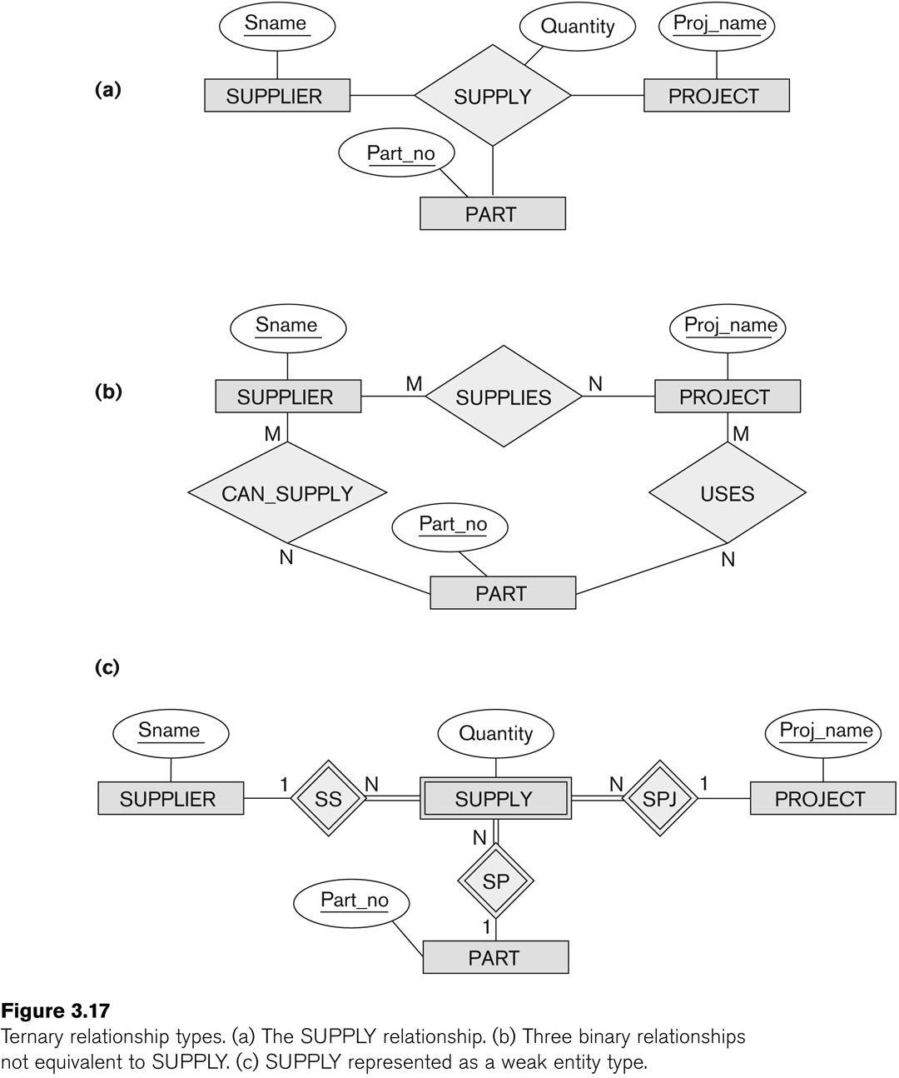
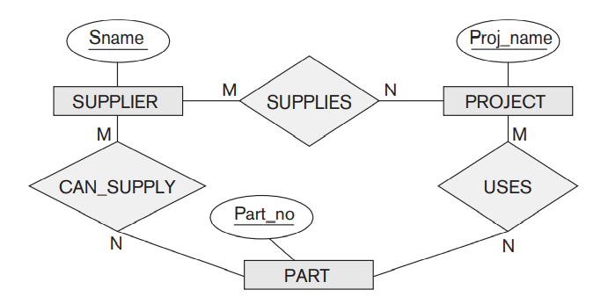
Notes:
Say for a given instance of Supplier and an Instance of Part, can that supplier supply that particular part for multiple Projects. Example − Consider a Supplier S1 that supplies a part P1 to the company and the uses the P1 supplied by Supplier S1 in its multiple projects in that case the cardinality of Project relative to Supplier and Part is N (many).
In case of Supplier’s cardinality we can say for a given instance of Project one of its Part can be supplied by multiple Suppliers.Example − Consider a Project pj1 that has a Part P1 and it is being supplied by multiple Suppliers in that case the cardinality of Supplier relative to Project and Part is M (many).
Similarly, for a given instance of Supplier and an instance for Project does the Supplier supply multiple Parts.Example − Consider a Supplier S1 supplying parts for Project pj1. in that case the cardinality of Part relative to Supplier and Project is P (many).

Slide 59
Alternative diagrammatic notation
ER diagrams is one popular example for displaying database schemas
UML class diagrams is representative of another way of displaying ER concepts

Slide 60
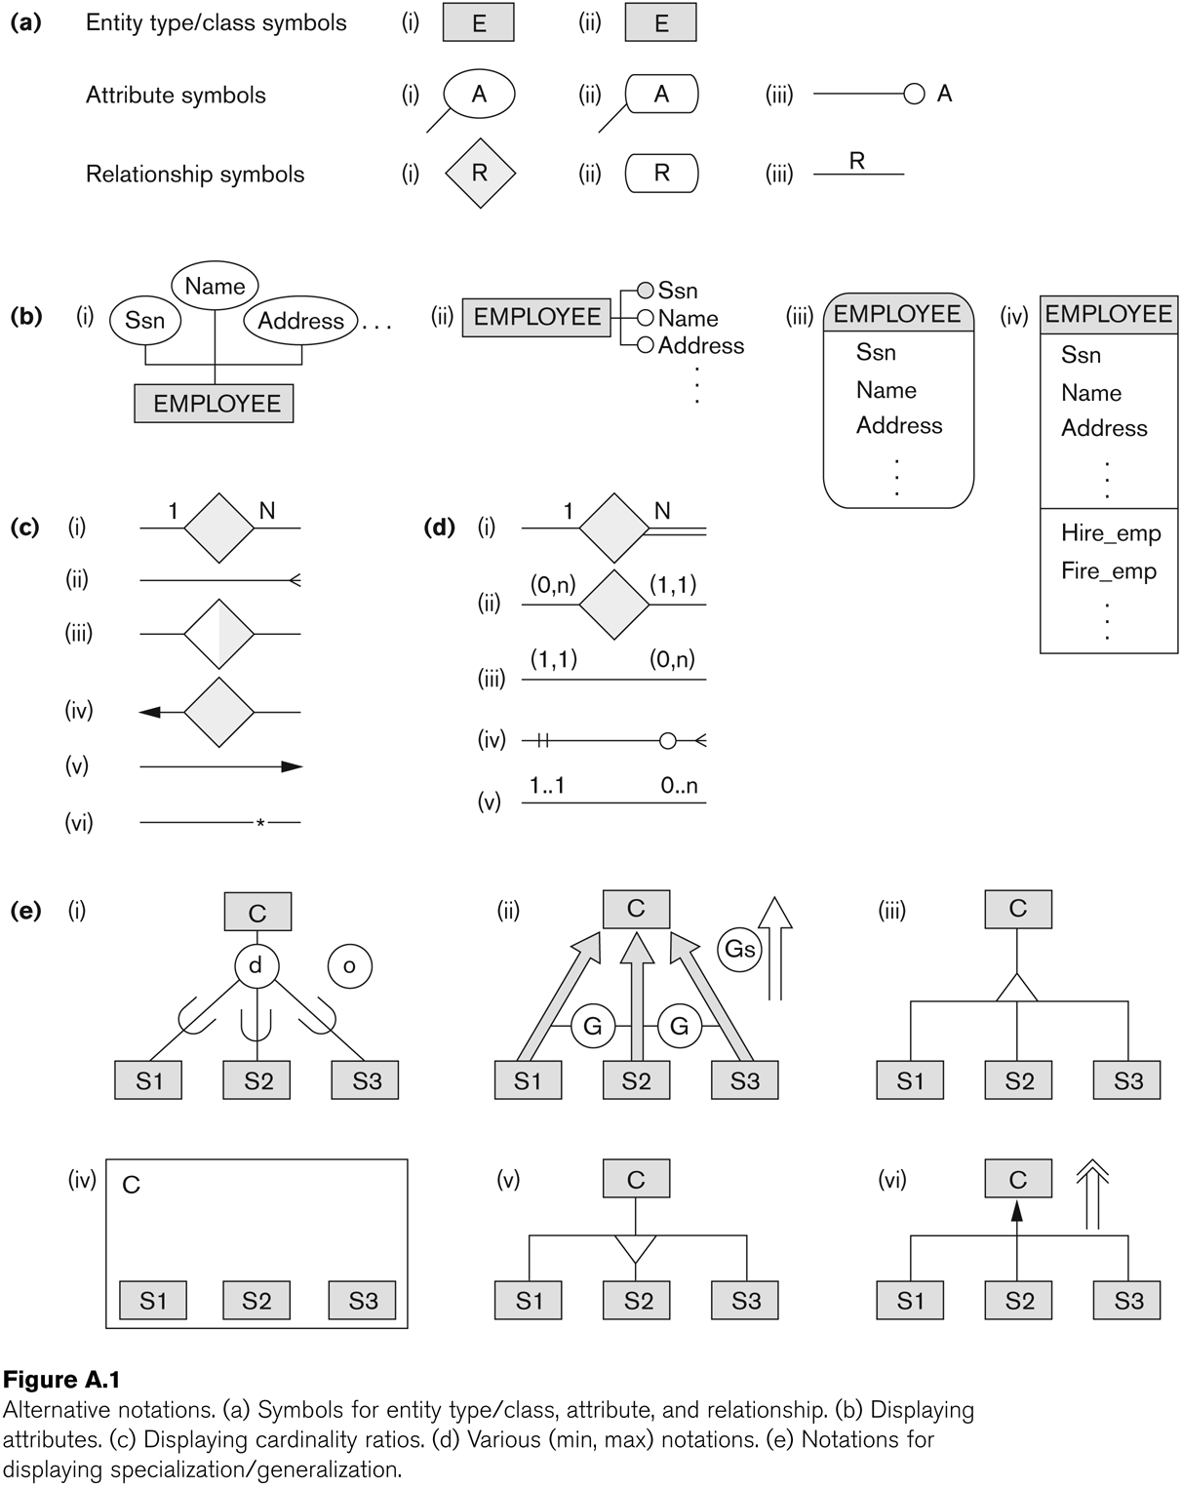
Other alternative diagrammatic notations

